Slide 1
Amazon Sales Dashboard
This project involves around Amazon Sales Data.
I was given task to find insights about it with respect to sales, profit, region and product.
I have used Claude.ai for finding my insights and Power BI to build this dashboard

Slide 2


Slide 3
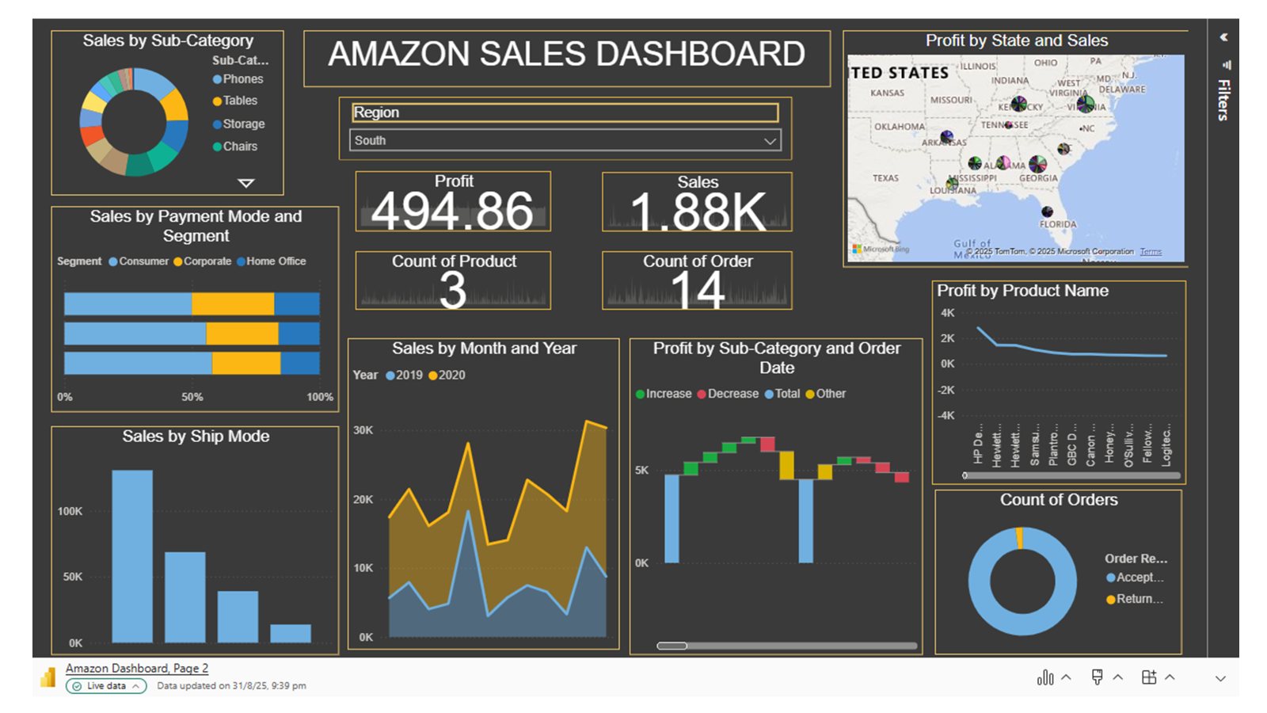
This char is used to display Sales made per Sub-Category according to the particular region.
This chart is used to display the Sales via Payment Mode per segment of the particular region
This chart is used to display the Sales via Ship Mode.

Slide 4
This Slicer is used to select the particular region of which we want to see the insights.
This Slicer is used to display total profit made in that region.
This slicer is used to display total Sales made in that region
This Slicer is used to display total count of products in that region.
This Slicer is used to display the total number of orders in that region.

Slide 5
This chart is used to display Sales by month for each year for the particular region.
This chart is used to display Profit made by sub-category according to the date they have been ordered for the particular region.

Slide 6
This chart is used to display the profit and sales made by the particular region geographically.
This chart is used to display profit made by each product in the particular region
This chart is used to display the number of orders accepted or rejected in that particular region.

